Slide 1
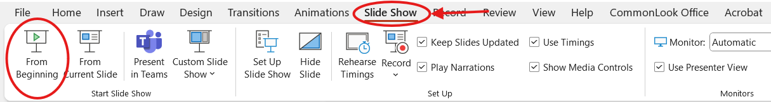
How to listen to this PowerPoint
Thank you for visiting UOCAVA/Move Act & California Elections Code training
To listen to the audio version of this Power Point, please be sure to watch it as a Slide Show. You may launch the Slide Show by accessing the Slide Show menu at the top of the screen and selecting “From Beginning”.

Slide 2

UOCAVA/
MOVE Act & CA Elections Code
Training for County Elections Officials
Updated August 2025

Slide 3
Acronyms (A-L)
COVR
CVR
EMS
California’s Online Voter Registration System
RegisterToVote.ca.gov
Conditional Voter Registration/
Same Day Registration
Elections Management System
FPCA
FVAP
FWAB
Federal Post Card Application
Federal Voting Assistance Program
fvap.gov
Federal Write-In Absentee Ballot

Slide 4

Acronyms (M-Z)
MOVE Act
RAVBM
SOS
Military and Overseas Voter
Empowerment Act
Remote
Accessible Vote By Mail
California Secretary of State
UOCAVA
Uniformed and
Overseas Citizens Absentee Voting Act
52 USC Ch. 203

Slide 5
Training Overview
UOCAVA voters
Ballot delivery methods
E-45 deadline
FVAP resources
UOCAVA surveys
Recent changes
Notes:
During this training we will cover UOCAVA voters, ballot delivery methods that are available to UOCAVA voters, sending ballots on or before E-45 which is the ballot transmission deadline for UOCAVA voters, the FVAP online training modules and the UOCAVA surveys that are sent out by the California Secretary of State’s office.

Slide 6
UOCAVA Voters
A UOCAVA voter is:
a U.S. citizen who is absent from the county in which they are otherwise eligible to vote
AND
one of the following:
Notes:
The definition of a UOCAVA voter is a U.S. citizen who is absent from the county in which they are otherwise eligible to vote and one of the following….

Slide 7
UOCAVA Classifications
A member of the U.S. Army, Navy, Air Force, Marine Corps, or Coast Guard; Merchant Marines; U.S. Public Health Service Commissioned Corps; National Oceanic and Atmospheric Administration Commissioned Corps of the U.S.; or on activated status of the National Guard or state militia
Residing outside the U.S.
A spouse or dependent of any of the above
A person born outside the U.S. who has not registered to vote in any other state and their parent/legal guardian was a California resident when parent/legal guardian was last living in the U.S.

Slide 8
Voter Registration Methods
COVR
FPCA
Paper voter registration card with a mailing address not in your county such as:
  A military address (APO/FPO)
  A non-military overseas address
UOCAVA voters must be flagged in the county’s EMS
Notes:
Some things to look for that may help you to determine if someone is a UOCAVA voter:
People who are registering using either COVR or the FPCA have the option of choosing one of the UOCAVA classifications when they fill out the application. This makes it a little easier when processing the application because they are telling you they are a UOCAVA voter. You still need to check and make sure they meet the UOCAVA eligibility requirements before you classify them as UOCAVA.
If they are registering using California’s paper voter registration card, that application does not have a classification section where the voter can tell you they are UOCAVA. This is where you will want to pay extra attention to the mailing address. Their mailing address must be different than their residence address and it must be outside your county. If they are using a military address, it can be within the US, or it might be outside the US, (like an APO or an FPO). If it’s a non-military voter, there will be an overseas address listed.
Once you have determined that someone is a UOCAVA voter, it’s very important that you flag them as such in your EMS.
Something to keep in mind, if a member of the military is registering and their residence address and mailing address are the same, they do not qualify for UOCAVA status. Remember that the mailing address outside the county along with the other UOCAVA requirements qualifies them. Being in the military does not automatically make someone a UOCAVA voter.

Slide 9

Conditional Voter Registration (CVR)
CVR is also known as Same Day Voter Registration
UOCAVA voters can use the CVR process to register and vote provisionally after the close of registration
A UOCAVA voter, who registers through COVR and uses their DMV signature, may request to cast a provisional ballot using a certified remote accessible vote by mail (RAVBM) system
CCROV #22085
Elections Code, section 2170(b)
Code of Regulations, section 20021 (Title 2, Division 7, Chapter 1, Article 3.5)
Notes:
Conditional Voter Registration, also known as Same Day Voter Registration became available to UOCAVA voters in 2022. A UOCAVA voter who wants to register after the 15-day close of registration can do so by filling out the COVR application, but only if they have a signature on file with the DMV. They cannot do same day registration using an FPCA or a paper voter registration card. After they have submitted their COVR application, they will need to contact your office to request you process their registration and send them a ballot using your RAVBM system.

Slide 10
Ballot Delivery Methods
In California, the following ballot delivery methods are permitted:
● Mail ● Email/Online ● Fax
COVR - if voter identifies as UOCAVA
Asks the voter to rank the available choices from 1-3 in order of preference
FPCA
Instructions ask the voter to select one preference
Notes:
In California, UOCAVA voters can choose to have their ballots delivered in one of three ways by mail, email/online or fax
If they register on COVR and identify themselves as a UOCAVA voter, it will open up the ballot delivery section of the online application and they will be asked to rank the three options in order of preference. They will have to select at least one of the options to submit their application.
If they are registering using the FPCA, they will be asked to select one ballot delivery method.
If they are registering using a paper VRC there is not a section on the form to indicate ballot delivery preference. If a voter does not indicate a ballot delivery preference, the UOCAVA default is mail.

Slide 11

Capture Preferred Delivery Method
There are three EMSs approved for use in California
All three systems can capture ballot delivery preferences
If you have questions about capturing ballot delivery preferences, please contact your EMS
Notes:
Once again, if you have identified a voter as UOCAVA, it’s very important that you flag that voter in your EMS and that you capture their preferred ballot delivery method. All three systems approved for use in California can capture a UOCAVA voters’ ballot delivery preference(s). If you have any questions about capturing ballot delivery preferences, please contact your EMS.

Slide 12
Send Ballots by Preferred Delivery Method
By mail or electronically
Electronically = email/online or fax
  Online delivery = emailing a link to county’s website where the voter can download and print ballot
Only email a ballot if the voter chose “email” as their preferred delivery method
Do not email a ballot just because you have the voter’s email address
Mail is the default method when the voter does not indicate a preference
Notes:
Once you’ve classified someone as a UOCAVA voter, flagged them in your EMS and captured their ballot delivery preference in your EMS, you will need to send their ballot to them using their preferred method, either by postal mail or electronically. In this case electronically means email/online or fax.
If the voter chose email as their preferred method, you will provide them with an RAVBM (Remote Accessible Vote-by-Mail) ballot; the voter will be emailed a link to your county’s website where they can download and print their ballot. In some cases, there may be an actual ballot document attached to an email rather than a link to an RAVBM, but in most counties voters who choose the email receive a link to the county’s RAVBM system.
If the voter chose fax as their preferred method, you will fax them a ballot, and if their preferred method is mail, you will send them a ballot in the postal mail.
You should not email a ballot just because you have the UOCAVA voter’s email address on file, you should only email their ballot if they chose email as their preferred ballot delivery method.
If a voter does not choose a ballot delivery preference, UOCAVA makes MAIL the default preference.

Slide 13
E-45 Deadline (Saturday)
Ballots MUST be transmitted no later than E-45
Best practice is to transmit ballots beginning E-60
E-45 always falls on a Saturday
Plan ahead to ensure ALL ballots including mail, email and fax go out on or before E-45
Do not wait until Monday E-47 to transmit them
Notes:
All UOCAVA ballots must be transmitted no later than 45 days before Election Day for all UOCAVA voters who were registered by then. California elections code permits county elections officials to begin transmitting UOCAVA ballots 60 days before Election Day. Best practice is to start transmitting ballots on E-60 and to continue transmitting them through E-45.
Reminder: E-45 always falls on a Saturday, and it does NOT roll forward to the following Monday. You should plan ahead to make sure all ballots using all three delivery methods go out on or before E-45. You will be asked to report on the number of ballots that were transmitted timely. I will go over this in more detail later in this presentation when we talk about the UOCAVA surveys.

Slide 14
E-45 Issues
  Vendor Issues
  Staffing Issues
  Technology Issues
  UOCAVA Registrations between E-60 & E-45
Notes:
Next we will go over some issues that have caused counties to be out of compliance with the E-45 deadline in prior years including vendor issues, staffing issues, technology issues and UOCAVA registrations that happen between E-60 and E-45. We want to make you aware of these issues so you can plan for them.

Slide 15
E-45 Vendor Issues
Educate vendors that E-45 means E-45
Issue | Problem | Solution
Communication | Lack of contact with vendor as to whether the vendor or county will transmit ballots | Clear and consistent communication with vendors well before E-60
Printing | Not receiving ballots from vendor until right before E-45 or even after E-45 | Send a PDF copy of the actual ballot, if available, by E-45
Mailing | Vendors mailed out a portion of the ballots on E-45 and then the remainder on Monday, E-43 | Educate and communicate with the vendor that all mailing must be done by E-45
Notes:
Some issues with vendors that we’ve been made aware of in the past are:
Communication issues – there was a lack of contact with the vendor regarding who was going to transmit the ballots, the vendor or the county. Make sure you communicate this requirement clearly with your vendor well ahead of time so there are no surprises.
Printing issues – ballots were not received from the vendor until right before E-45 or even after E-45. Sometimes things happen that are out of your control, or even out of the vendor’s control. If you don’t receive your ballots in time to make the E-45 deadline, you can ask for a pdf copy of the actual ballot and print them yourself on regular paper so you can send them out by E-45.
Mailing issues – where the vendor mailed out a portion of the ballots on E-45 and the remainder the following Monday. This is another reason why it’s important to educate your vendors that all mailings must be done by E-45.

Slide 16
E-45 Staffing Issues
Understand the importance of the E-45 deadline
DO NOT send out mail on Saturday, E-45 and leave the emails and faxes for Monday, E-43
All ballots must be sent on or before E-45
DO NOT get the majority of work done on Saturday, E-45 and leave the rest for Monday, E-43
Plan ahead and pull in help early
Understaffed?
Start transmitting ballots at E-60
Notes:
It’s very important that county staff understand the E-45 ballot transmission deadline and that it applies to all ballot delivery methods. For example, they need to know they cannot send out the mailed ballots on E-45 and leave the emails and faxes for Monday, E-43. They also need to know they cannot get most of the work done on E-45 and leave the rest for Monday.
If it looks like you might be understaffed, plan ahead and pull in help early. Plan to begin transmitting ballots at E-60 so you have the full 15-day transmission window and you’re not trying to send them all out on E-45.

Slide 17




E-45 Technology Issues
Email issues
Address label issues
Work in advance with your county’s IT Department
Plan, plan, plan
Test, test, test
IDEA: Send a test email to UOCAVA voters. This can help with load testing and to cure emails being returned as “undeliverable”
Notes:
Some of the technology issues we have heard about have to do with email issues and address labels. Please work with your IT department well in advance of E-60 to make sure you can successfully transmit ballots in a timely manner. Planning and testing are key to success. You might want to send out a test email to your UOCAVA voters, this can help with resolving address issues for emails that may bounce back as undeliverable. One of the biggest factors in the military and overseas voting process is the timely delivery of election materials to the correct address.

Slide 18

Registrations Between E-60 and E-45
If UOCAVA registrations come in after E-60, but by E-45, counties must capture those voters and transmit ballots by E-45.
If a UOCAVA registration comes in after E-45, transmit a ballot as soon as practicable. (Elections Code, section 3114(b).)
Notes:
Many counties start transmitting ballots at E-60, which we encourage. But if you transmit all ballots on E-60 to voters who are registered on E-60, you are not done. You must have a procedure in place to capture any UOCAVA registrations that come in between E-60 and E-45 and to transmit ballots to those voters by E-45.
For UOCAVA registrations that come in after E-45, you can transmit ballots to those voters as soon as practical.

Slide 19
E-45 Bottom Line
Your office must have procedures and plans in place to transmit by E-45
Transmit ballots via voters designated preferred method of delivery
BEST PRACTICE:
Start transmitting at E-60
Elections Code, sections 3105 and 3114
Notes:
Bottom line, you must have procedures in place to successfully transmit ballots by E-45, using the UOCAVA voters preferred ballot delivery method. We do recommend you start transmitting ballots at E-60.

Slide 20

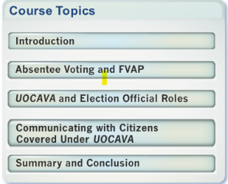

FVAP Resources
Training:
FVAP has online training modules for Elections Officials: fvap.gov/eo/training
A link to the FVAP training pages is also available on SOS’s Military & Overseas Voters webpage:
https://www.sos.ca.gov/elections/voter-registration/military-overseas-voters/resources
Notes:
Now I’d like to make you aware of some of the resources offered by the Federal Voting Assistance Program. FVAP has many resources available online for military and overseas voters and for county elections officials. There is an online training module for county elections officials at fvap.gov/eo/training. Once you are on the training page you can select Election Official Training from the drop down. The topics covered in the course are Absentee Voting and FVAP, UOCAVA and Election Official Roles and Communicating with UOCAVA voters. You can also get to the FVAP training pages from the Military and Overseas Voters webpage on the SOS website and we’ve provided a link to that page at the bottom of the slide.

Slide 21
Military Address Lookup
FVAP can look up active-duty service members' addresses for elections officials
  Email vote@fvap.gov or fax your request to (571) 372-0735 or (571) 372-0749
Be sure to include:
    your name and jurisdiction
    voter's full name, date of birth (mm/dd/yyyy)
    the last four digits of their Social Security Number
FVAP can only give available and releasable information. They do not have access to information on service members' eligible family members or overseas citizens.
Notes:
FVAP can look up active-duty service members addresses for elections officials. To utilize this service, send an email to vote@fvap.gov or fax your request to one of the fax numbers listed on this slide. Be sure to include your name and jurisdiction, the voter’s full name and date of birth and the last four digits of their social security number. This service is only available for active-duty service members, it is not available for their eligible family members or overseas citizens.

Slide 22

UOCAVA Surveys
Following a 2012 consent decree, the U.S. Department of Justice requested the SOS continue to survey counties for UOCAVA transmission data.
Surveys focus on the transmission of UOCAVA ballots by E-45
SOS must submit the results of the survey to the U.S. DOJ by E-43
Notes:
A little history on why we do the UOCAVA Surveys. Back in 2012, some of the county elections offices in CA did not transmit ballots to all their registered UOCAVA voters by the E-45 deadline and some did not transmit UOCAVA ballots by the voter’s preferred method. The CA SOS was sued by the federal government for failure to comply with UOCAVA and the MOVE Act. Rather than go to court, the SOS entered into a consent decree that required us to survey the counties after each Federal election and submit the survey results to the US DOJ by E-43. After the consent decree expired, the DOJ requested we continue to provide the surveys.

Slide 23



CCROVs
SOS sends a series of three CCROVs during each election cycle:
UOCAVA/MOVE Act Survey/Point of Contact
UOCAVA/MOVE Act Survey and Schedule
UOCAVA/MOVE Act Survey
Notes:
Our office sends out three separate CCROVs for each survey. There is the Point of Contact Survey, the Survey and Schedule and the actual Survey.

Slide 24

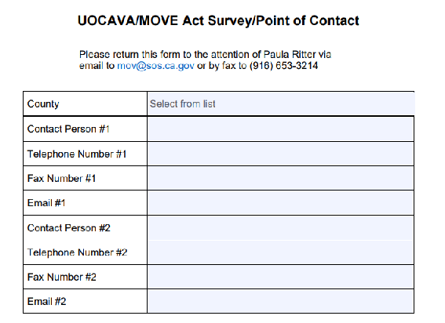
Point of Contact Survey
Request for county staff contact information
Example of Point of Contact Survey CCROV
Notes:
The first CCROV is the Point of Contact Survey. On this one we ask you to provide contact information for staff who will be submitting the survey and who will be available for questions on E-43, if we have any. This CCROV is issued about a week before E-60.

Slide 25
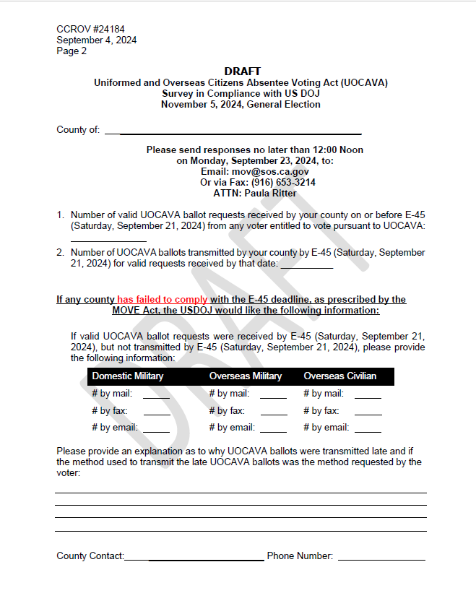
Survey and Schedule
Survey reporting schedule and draft of survey
Example of Survey and Schedule CCROV
Notes:
The second CCROV contains a draft of the actual survey and the survey reporting schedule. This CCROV usually goes out right around E-60.

Slide 26
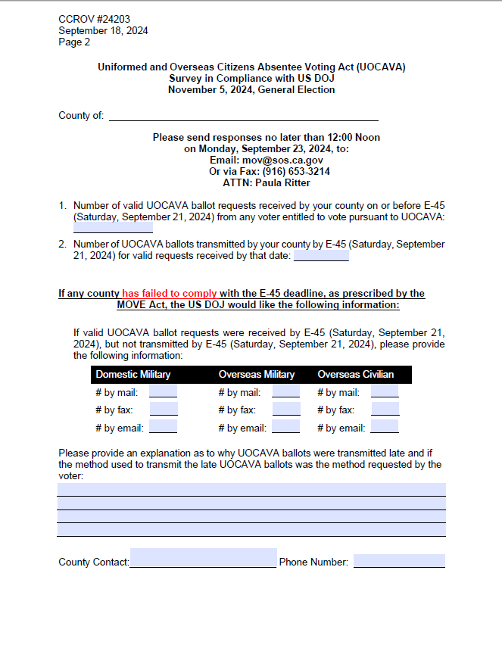
Survey
  Actual survey with deadline (E-43 noon) for reporting to SOS
  Example of Survey CCROV
Notes:
The final CCROV contains the actual survey along with the submission deadline, which is E-43 at noon to our office.
The first item on the survey asks you to report the number of ballots that were requested on or before E-45. The second item asks you to report the number of ballots transmitted by E-45. Those numbers should be the same. If you transmitted all UOCAVA ballots by E-45 then you are done and do not need to fill in anything else on the survey.
If you did not transmit all UOCAVA ballots by E-45, then you will need to complete the third item which asks you to report the number of ballots that were not transmitted timely. They need to be reported by voter category and by ballot delivery method. You will then need to provide an explanation as to why the ballots were transmitted late and what steps have been taken to resolve the late transmission . This is something we hope to avoid, but it does happen on occasion.

Slide 27

SOS reports to U.S. DOJ
On E-43, SOS compiles survey responses and provides a report to U.S. DOJ
Notes:
Once we have received all of your survey responses, we compile them into a single report that Elections Counsel sends to the US DOJ by the end of the day on E-43. As you can see, we have a tight turnaround, so if we don’t hear from you, we will be calling.
If there are vacancy elections for state office holders, we will request the compliance information in a different way. For example, we send emails to the specific county or counties conducting the vacancy elections asking for confirmation that all ballots were transmitted timely, instead of requiring completed surveys.

Slide 28
Recent Changes
DoD Fax Service Discontinued
Effective August 1, 2025, FVAP has discontinued their service of faxing UOCAVA voters' ballots to county elections officials.
UOCAVA voters who wish to return their voted ballots by fax must do so using a fax machine - they can no longer send their ballots to fax@fvap.gov.
will fax it to their county elections office.
AP will fax it to their county elections office.
Notes:
Effective August 1, 2025, FVAP has discontinued their service of faxing UOCAVA voters' ballots to county elections officials.
UOCAVA voters who wish to return their voted ballots by fax must do so using a fax machine - they can no longer send their ballots to fax@fvap.gov.

Slide 29

Final Reminders
The E-45 deadline is required by federal and California law
E-45 means E-45:
  By the UOCAVA voters designated preferred delivery method
  It does NOT mean the following Monday
Best Practice:
• Start transmitting at E-60 (Elections Code, sections 3105 and 3114)
• Continue transmitting any requests received by E-45
Notes:
Here it is again, in case we haven’t stressed it enough, the E-45 deadline is always on a Saturday, it does not roll to the following Monday. You need to transmit voter’s ballots to them using their designated preferred delivery method. Best practice is to start transmitting UOCAVA ballots on E-60 and to continue transmitting them through E-45. The E-45 deadline is required by both federal and California law.

Slide 30

Questions?
SOS MOV Coordinators
Please contact us with any UOCAVA questions or concerns about meeting the E-45 ballot transmission deadline
Email: mov@sos.ca.gov
Federal Voting Assistance Program
Contact: Sara Hedlund
Email: sara.m.hedlund.civ@mail.mil
Notes:
This brings us to the end of the training. We’d like to thank you for attending. If you have any questions, please reach out to the Military and Overseas Voters Coordinators at the Secretary of State’s office. We can be reach by email at mov@sos.ca.gov.
You can also reach out to the Federal Voting Assistance Program. Our point of contact at FVAP is Sara Hedlund and she can be reached at sara.m.hedlund.civ@mail.mil.

