Slide 1
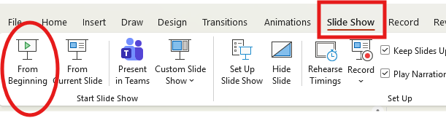

How to listen to the audio version of this PowerPoint
To listen to the audio version of this Power Point, please be sure to watch it as a Slide Show.
Launch the Slide Show by accessing the Slide Show menu at the top of the screen and selecting “From Beginning”.
Notes:
To listen to the audio version of this Power Point, please be sure to watch it as a Slide Show. You can launch the Slide Show by accessing the Slide Show menu at the top of the screen and selecting “From Beginning”.

Slide 2

National Voter Registration Act and
Voter Registration Agencies
Training for
County Elections Officials
Updated January 2026
Notes:
Welcome to training on the National Voter Registration Act and Voter Registration Agencies. This training was designed for County Elections Officials and was last updated in January 2026.

Slide 3




Training Overview
National Voter Registration Act (NVRA) and California Elections Code
Roles of the SOS, County Elections Officials and Voter Registration Agencies (VRAs)
County Elections Officials responsibilities
Voter registration in action at VRAs
Notes:
During this training we will go over:
The National Voter Registration Act, which is federal law, and the California law associated with it.
The roles of Voter Registration Agencies, County Elections Officials and the Secretary of State.
We will cover the responsibilities of County Elections Officials, with an emphasis on monthly reporting.
And we will go over what voter registration looks like in action at Voter Registration Agencies (VRAs):
We will talk about the two forms that VRAs must have available to give their clients
And when and how those two forms are required to be given out
We’ll also let you know what we go over when we train them so you can be prepared if they come to you with questions

Slide 4
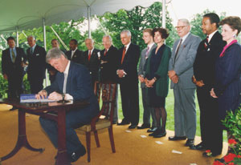
NVRA and California Elections Code
NVRA signed in 1993
The right to vote is a fundamental right
Federal, state and local governments have a duty to promote voting
Notes:
The National Voter Registration Act (NVRA) was signed into law in 1993 and went into effect in 1995.
The NVRA established voting as a fundamental right, and says federal, state, and local governments have a duty to promote voting.

Slide 5



NVRA Goals
Easier for U.S. citizens to register to vote
Increase voter registration in underserved and disabled communities
Remedy past discrimination in voting
and voter registration
Protect against purging voter rolls
Notes:
The NVRA was designed to make it easier for eligible citizens to register to vote and to increase voter registration in underserved and disabled communities.
It also aims to remedy past discrimination and to protect against removing eligible voters from the voter rolls by establishing a uniform, non-discriminatory list maintenance program.

Slide 6




NVRA Requirements
Voter Registration offered at DMV offices
Mail in Voter Registration forms
Voter Registration Agencies
Administration of Voter Registration
Notes:
The NVRA requires states to offer voter registration at the DMV whenever someone applies for or renews their driver’s license or ID card or changes their address. You may have heard this referred to as the Motor Voter Law.
It also requires states to accept the federal mail voter registration application that was developed by the U.S. Election Assistance Commission. It allows states to use their own forms if they meet all the same criteria as the federal form. It also requires the states to make voter registration applications readily available.
The NVRA designates public assistance agencies and state-funded programs primarily engaged in providing services to persons with disabilities as Voter Registration Agencies. VRAs are required to offer voter registration services. States must also designate additional agencies as Voter Registration Agencies to reach more eligible voters.
Lastly, the NVRA requires certain actions be taken by states regarding the administration of voter registration. This includes important issues such as the date by which valid voter registration applications must be accepted and eligible persons registered, rules for changing a registrant’s address information, rules for removing names from the voter registration list, and the administration of a uniform, nondiscriminatory voter registration list maintenance program that complies with the Voting Rights Act.

Slide 7
California Elections Code
NVRA added to California Elections Code, sections 2400-2408
3-part team:
Secretary of State’s office
County elections officials
Voter Registration Agencies
Added reporting responsibilities
Notes:
The NVRA was added into California elections code along with some additional requirements.
California created a three-part team consisting of the Secretary of State’s Office, county elections officials, and Voter Registration Agencies. The team members work together to implement the NVRA and to remain in compliance.
California also added NVRA reporting responsibilities. The Secretary of State’s office collects NVRA voter registration statistics and posts them to our website monthly. This gives VRAs the opportunity to review the reports and make sure their numbers are reflected accurately.

Slide 8

Roles and
Responsibilities
SOS
County Elections Officials
SOS-tracked VRAs
County-tracked VRAs
8
Notes:
Previously, we mentioned the NVRA was added into California Elections Code and created a 3-part team.
This is a diagram of the 3-part team. We are going to cover what each team member is responsible for in the slides that follow, but I would like to draw your attention to the County Elections Officials team in the upper right of the slide. County Elections Officials have a direct line to both the SOS and to county-tracked VRAs. This is because County Elections Officials provide voter registration cards to county-tracked VRAs and report registrations received from those VRAs to the SOS each month.

Slide 9





Secretary of State
Coordinate with county elections officials and VRAs on implementation
Publish monthly reports with voter registration numbers from VRAs and each of their offices and sites
Publish biennial voter registration reports for the US Election Assistance Commission (EAC)
Prepare training materials
Notes:
As our part on the 3-part team, the Secretary of State’s office must coordinate with county elections officials and VRAs to implement the NVRA.
This office publishes monthly reports that show the voter registration numbers from Voter Registration Agency offices and sites.
We must also publish voter registration reports for the US Election Assistance Commission every two years.
Finally, the Secretary of State’s office must make NVRA training materials available to counties and Voter Registration Agencies.

Slide 10

County Elections Officials
Designate an NVRA Coordinator
Maintain a VRA roster
Provide VRCs to VRAs in the county
Track VRCs issued to VRAs and report to:
SOS - each month
EAC - every two years
Assist VRAs with training, upon request
Notes:
As your part on the 3-part team, County Elections Officials must designate a county NVRA Coordinator and place known Voter Registration Agency offices and sites on a county roster.
You must provide voter registration cards to county-tracked VRAs.
The county must also track the VRCs provided to county-tracked VRAs, and each month, the county NVRA coordinator will report the voter registration numbers from each VRA to the Secretary of State.
Every other year, you will also report voter registration numbers to the US Election Assistance Commission.
Lastly, county elections officials must assist VRAs with training upon request.

Slide 11
Voter Registration Agencies
Offer Voter Registration
Designate an NVRA Coordinator at each location
Notify county elections officials of the location of each of office and site
Print VPFs
from SOS website in required languages
Order VRCs in required languages
Train staff on NVRA requirements, annually and upon hire
Notes:
A Voter Registration Agency’s role on the 3-part team is to offer voter registration at each of their offices and sites.
They must designate an NVRA coordinator at each site and they must register each of their locations with their county elections office.
VRAs must print Voter Preference Forms from the Secretary of State’s website. They should print these forms in each language required in the county by the federal Voting Rights Act. If a VRA is uncertain which languages are required, the county elections office can provide this information.
County-tracked VRAs order voter registration cards in each of the required languages from their County Elections office.
Voter Registration Agencies have the responsibility to train their staff to comply with the NVRA. The NVRA requires that VRAs provide training to all staff that participate in NVRA transactions at least once per year. We will go over what those transactions are a little later in this presentation.
VRAs must also ensure that all new employees receive training promptly so that they can comply with the NVRA during their interactions with clients.

Slide 12
Voter Registration Agency Categories
Five categories of non-DMV VRAs
Public Assistance
Disability Service
Armed Forces Recruitment
Voluntary
Other
Notes:
In California there are five categories of VRAs, other than the DMV:
Public assistance agencies
Disability service agencies
Armed forces recruitment offices
Voluntary designations.
Other agencies designated by the Secretary of State

Slide 13
California’s County-tracked VRAs
List of VRAs on the SOS website
Agency | VRA Category
Armed Forces Recruitment Offices | Armed Forces Recruitment Offices
California Department of Social Services in connection with the CalFresh Program | Public Assistance
California Department of Tax and Fee Administration District Offices | Other
County Health/Human Service Offices (CalFresh, CalWORKs, MediCal) | Public Assistance
County offices that administer General Assistance/General Relief Programs | Public Assistance
Covered California (California’s Health Benefit Exchange/HBEX)* | Public Assistance
Department of Developmental Services - Regional Centers | Disability Service
*Covered California is a county-tracked VRA that orders VRCs from SOS
Notes:
County-tracked agencies that have been designated as VRAs by the California Secretary of State are listed on this slide and the next, in alphabetical order. The list also tells you which category each VRA falls under. These are the agencies that should be listed on your NVRA reports.
A note about Covered California. They are a county-tracked VRA, but the SOS provides them with VRCs. We provide your offices with the VRC numbers so you can track them. We will go over this process and the reason for it in more detail further along in this presentation.
Since we continue to designate new agencies, we encourage you to visit our webpage for the most up to date list. A complete list of California’s VRAs can be found on our website at the link listed at the top of the slide.

Slide 14
California’s County-tracked VRAs (continued)
Agency | VRA Category
Department of Rehabilitation - Vocational Rehabilitation Services | Disability Service
Department of Social Services - Office of Deaf Access Contractors | Disability Service
Franchise Tax Board District Offices | Other
Independent Living Centers | Disability Service
In-Home Supportive Services (IHSS) | Disability Service
Shingle Springs Health & Wellness Center and satellite offices | Native American Sovereign Entities (Voluntary)
State & County Mental Health Providers | Disability Service
Private entities under contract with the agencies listed above to provide NVRA-related services
Notes:
This is a continuation of the county-tracked VRA list from the previous slide.
Down at the bottom of the list you will see private entities under contract with these agencies to provide NVRA-related service. These entities must also comply with the NVRA. They would fall under the same category as the VRA they provide services for.

Slide 15
California SOS-tracked VRAs
Agency | VRA Category
California Department of Corrections and Rehabilitation, Division of Adult Parole Operations (DAPO) | Other
California Student Aid Commission (CSAC) | Public Assistance
Department of Moter Vehicles (DMV) | DMV
Office of Services to the Blind - Assistance Dog Special Allowance Program | Disability Services
University of California (UC), California State University (CSU), and California Community College (CCC) offices providing services to students with disabilities | Disability Services
Private entities under contract with the agencies listed above to provide NVRA-related services
Notes:
This is a list of SOS-tracked VRAs. Our office provides these agencies with VRCs, and we track and report the registrations received from them. This includes the DMV. The DMV is its’ own category and has its’ own set of reports.
None of these agencies should be listed on the NVRA reports you submit to our office each month. If you report them then they are being double counted.

Slide 16
County Responsibilities
Designate an NVRA Coordinator
Maintain a VRA Roster
Provide VRCs to VRAs
Track VRCs and report to:
SOS - each month
EAC - every two years
Assist VRAs with training
Notes:
County Elections offices are responsible for designating an NVRA Coordinator, maintaining the county’s VRA roster, providing VRCs to VRAs in the county, tracking and reporting registrations from VRAs to the SOS each month and to the EAC after every federal election and assisting VRAs with training when requested.

Slide 17
Designate an NVRA Coordinator
Each county must designate an NVRA Coordinator
NVRA Coordinators report the voter registration counts from each VRA office and site to the SOS monthly
Each county must have a back up NVRA Coordinator to ensure monthly reports are submitted timely
Please reach out to the SOS with updated contact information any time there are staffing changes
Notes:
Each county must designate an NVRA Coordinator and have at least one backup coordinator so the monthly reports can be submitted to our office timely, in case the NVRA coordinator is not available.
The county NVRA coordinator is responsible for reporting registrations from VRAs to our office monthly. The reports are due to our office by the 10th of the following month.
Please let us know as soon as possible if there are any NVRA staffing changes at your offices so we can maintain an updated contact list.

Slide 18


Maintain a VRA Roster
The County NVRA coordinator places known VRAs, and each of their offices and sites, on a county VRA roster:
VRAs should contact your office to introduce themselves
VRAs should also identify their NVRA Coordinator to you
VRAs should identify each of their offices and sites within the county
Reach out to VRAs within your county if they have not contacted your office (best practice)
Notes:
The county NVRA Coordinator is responsible for maintaining a roster of VRAs located in their county.
When we train the VRAs, we let them know it is their responsibility to contact your office and identify themselves as a VRA so that you will know to add them to your county roster, and to track and report registrations that come from their clients. The VRAs should provide you with information on each of their office and sites that are present within your county, and each of those offices and sites should be listed on your VRA roster.
The VRAs should also let you know who their NVRA Coordinator is and provide their contact information to you.
While we instruct VRAs to reach out to your office, it is best practice for you to reach out to them if they have not contacted you.

Slide 19

Find VRAs in the County
Public Assistance VRAs:
County Social Services Departments (CalFresh, CalWORKS, Medi-Cal)
Women, Infants, and Children (WIC)
Disability Service VRAs:
Department of Rehabilitation – offices offering vocational rehab services
Independent Living Centers (ILC)
In-Home Supportive Services (IHSS)
Regional Centers (RC)
Contractors with the Office of Deaf Access
State and county mental health providers and contractors
Notes:
While we instruct the VRAs to reach out to your office and introduce themselves, it is best practice for you to reach out to them if you have not heard from them.
One of the ways you can find VRAs in your county is to check the webpages listed on this slide. We have provided links for the Public Assistance category and the Disability Service Agency category on this slide.

Slide 20

Provide VRCs to VRAs
When VRAs request VRCs:
Record the affidavit numbers of the VRCs issued
Track VRC affidavit numbers by VRA and location
When VRCs are returned by VRA clients, the tracked affidavit numbers ensure the VRA is credited for complying with the NVRA
Notes:
Your offices are also responsible for providing VRCs to Voter Registration Agencies within your county. You are required to record the affidavit numbers of the VRCs you issue to VRAs and to track them by location. Tracking the VRCs allows you to report the registrations from them to our office each month, so that the VRA receives credit for complying with the NVRA.

Slide 21


Track VRCs
Request and review VRC inventory sheets:
Best practice: VRAs submit inventory sheets of existing VRCs to your office
Inventory sheets should contain the affidavit numbers of current VRC stock of VRCs at each location
Review the inventory sheets to make sure the affidavit numbers are on record at your office and correspond to the VRA
Notes:
We recommend that each VRA office and site keep an inventory sheet of their existing VRCs and affidavit numbers and submit these inventory sheets to your office. This will allow you to confirm that you have their affidavit numbers on record and that they correspond correctly to each office and site.

Slide 22
Tracking CalSAWS and HBX VRCs
CalSAWS and HBX are county-tracked VRAs
Their application/renewal packets are mailed to clients from a centralized distribution facility
SOS sends SOS VRCs directly to the centralized distribution facilities
SOS emails the CalSAWS and HBX affidavit ranges to the counties
The spreadsheet lists ALL CalSAWS and HBX affidavit ranges (new and previously issued)
Notes:
CalSAWS and California Health Benefits Exchange, or HBX, are county-tracked VRAs, which means that their registrations are tracked and reported at the county level.
However, CalSAWS and HBX programs have their application and/or renewal packets mailed to clients from a centralized distribution facility. The packets include VRCs that provide their clients with an opportunity to register to vote.
It is impractical for the centralized distribution facilities to maintain a supply of county VRCs from each of the 58 counties, in all the languages required, so they are provided with SOS VRCs.
To allow counties to track registrations from these SOS cards, the SOS will send an email to the county NVRA coordinators each time a CalSAWS or HBX VRC order is placed. This email includes all of the VRC affidavit ranges that have been issued to CalSAWS or HBX.

Slide 23

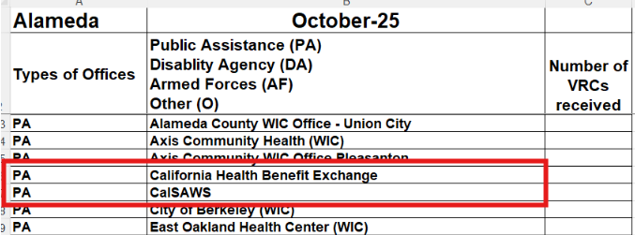
Reporting CalSAWS and HBX
Counties must enter the VRC affidavit ranges in their EMIS so registrations from these agencies will be included on the monthly NVRA reports.
Cal SAWS and HBX are reported in the PA Category:
Notes:
The NVRA coordinator at each county must enter the affidavit ranges for HBX and CalSAWS into their EMS and include any registrations from these affidavits that are processed each month into the monthly NVRA reports.
If you have any questions about this, please contact the SOS NVRA team

Slide 24
Monthly Reporting to SOS
NVRA reports are due to SOS by the 10th of the following month
SOS emails a request for NVRA registrations
The email contains the following attachments:
Monthly Reporting Spreadsheet
County Reporting Memo
Instructions on how to complete the monthly reports
Counties must have a backup NVRA Coordinator to ensure reports are submitted timely
Link to NVRA Reports on SOS website
Notes:
Each county elections office must report their monthly registration numbers by the 10th of the following month.
At the beginning of every month our office sends an email to county NVRA coordinators requesting the previous month’s registration numbers . The email contains three attachments:
The monthly reporting spreadsheet
The county reporting memo PDF
Instructions on how to complete and submit the monthly reports to our office
Counties should provide a backup to the NVRA coordinator to ensure that the reports arrive to the SOS by the statutory deadline. Please also note that you must submit a report even if you have recorded zero registrations for the month.
You can find the reports that we post each month at the link at the bottom of this slide.

Slide 25
Monthly Reporting Spreadsheet
Public Assistance
Organized by reporting agency category
Disability Service
Armed Forces Recruitment
Native American Sovereign Entities
Other
Undistinguishable
Notes:
The Monthly Reporting spreadsheet is organized by reporting agency category. There are 6 different categories. Public assistance agencies, state-funded agencies primarily providing services to people with disabilities, Armed Forces Recruitment Offices, Native American Sovereign Entities, Other agencies, and Undistinguishable. We will go over what belongs in each category in the slides that follow.

Slide 26
Public Assistance Agencies
Report in the PA category:
County welfare offices that accept applications and administer benefits for:
CalFresh
CalWORKS
MediCal
WIC
California Health Benefit Exchange
California Department of Social Services CalFresh program
County General Assistance/
General Relief Programs
Private entities under contract with any of these offices to provide NVRA-related services
Notes:
In the Public Assistance Agencies category, you should report registrations from:
County welfare offices that accept applications and administer benefits for CalFresh, CalWorks and MediCal.
California Health Benefit Exchange, also known as Covered California.
California Department of Social Services offices that accept application and administer benefits for the CalFresh program
County offices that accept applications and administer benefits for the General Assistance/General Relief Programs
Any private entities under contract with any of these offices to provide NVRA-related services.

Slide 27
Disability Service Agencies
Report in the DA category:
County welfare departments, which accept applications and administer benefits for In-Home Supportive Services Program (IHSS)
Department of Developmental Services Regional Centers
Department of Social Services, Office of Deaf Access
Independent Living Centers
State and County Mental Health Providers
State Department of Rehabilitation
Any private entities under contract with any of these offices to provide NVRA-related services
Notes:
In the DA category for agencies primarily serving persons with disabilities, you should report registrations from:
County welfare departments, which accept applications and administer benefits for In-Home Supportive Services Program,
Department of Developmental Services Regional Centers;
Department of Social Services, Office of Deaf Access;
Independent Living Centers;
State and County Mental Health Providers;
State Department of Rehabilitation, and
Any private entities under contract with any of these offices to provide NVRA-related services

Slide 28

Armed Forces Recruitment Offices
Report in the AF category:
Air Force, Army, Coast Guard, Marines, Navy, Space Force
Many armed forces recruitment offices use the federal form when offering voter registration.
This applies ONLY to Armed Forces Recruiting Offices. Forms received from other veterans’ agencies or military/overseas voters should not be reported here.
This applies ONLY to Armed Forces Recruiting Offices. Forms received from other veterans’ agencies or military/overseas voters should not be reported here.
Notes:
Under the Armed Forces Recruitment Offices or (AF) section, you should report any registration from Air Force, Army, Coast Guard, Marine, Navy or Space Force recruitment offices.
Many armed forces recruitment offices don’t request VRCs from county elections officials and instead use the Federal Post Card Application, or FPCA when offering voter registration. Often, the recruiting office name and address will appear in the return address section of the FPCA indicating that it is an armed forces recruitment office. If that is that case then those registrations should be included in the monthly NVRA reporting.
Please note that the NVRA requirement applies only to recruitment offices, so FPCAs received from veteran’s agencies or military/overseas voters should not be reported in this section.

Slide 29

Native American Sovereign Entities
Report in the NA category:
Voluntary designation
Currently includes Shingle Springs Health & Wellness Center and satellite offices, which provide healthcare to members of the Shingle Springs Band of Miwok Indians and the surrounding communities
Shingle Spring Health & Wellness Center is in El Dorado County
Notes:
Shingle Springs Health and Wellness Center was a voluntary designation. We created the Native American Sovereign Entities category to hold these registrations, This category currently contains one VRA, which is in El Dorado County, so most of you will not have this on your monthly reports until we designate additional Native American entities that may be in your area.

Slide 30
Other Agencies
Report in the O category:
Franchise Tax Board
California Department of Tax and Fee Administration
Any private entities under contract with these offices to provide NVRA-related services
Specific to the agencies listed above
NOT a catchall
Unsure? Contact the agency or SOS for guidance
Notes:
Under the “other agencies” category you should report registrations from the Franchise Tax Board offices, the California Department of Tax and Fee Administration, and any private entities under contract with these agencies to provide NVRA-rated services. These are the ONLY agencies that should be reported in the Other category. Other should not be used as a catchall if you are not sure which category an agency fits into. If you need help determining where an agency should go you can contact that agency directly or reach out to our office.

Slide 31

Undistinguishable
Report in the U category:
Agencies that cannot be identified
Agencies not added to your EMIS yet
Undistinguishable counts should be minimal
Notes:
Finally, the undistinguishable category is used for VRCs received from an agency that has not been added to your EMS yet. Undistinguishable counts should be minimal and should not carry over from month to month.

Slide 32

What NOT to Report
SOS-Tracked Agencies:
California Student Aid Commission (CSAC)
Department of Corrections and Rehabilitation, Division of Adult Parole Operations (DAPO)
Department of Motor Vehicles (DMV)
Department of Social Services, Office of Services to the Blind, Assistance Dog Special Allowance Program
Offices for students with disabilities at Universities of California, California State Universities, and California Community Colleges
Any private entities under contract with these offices to provide NVRA-related services
Notes:
As mentioned previously, SOS-tracked agencies order their VRCs from the SOS and the registrations received from those VRCs are tracked and reported by the SOS. Registrations from these agencies should not be included on your Monthly Reporting Spreadsheet or your County Reporting Memo (PDF).

Slide 33
What NOT to Report (continued)
Undesignated VRAs:
County Clerks/Recorders Offices
Employment Development Department
Law Enforcement Offices
League of Women Voters
Libraries
Social Security Administration
Notes:
This slide lists examples of some agencies that should not included on your monthly NVRA reports because they have not been designated as Voter Registration Agencies.
California Elections Code requires VRAs to notify county elections officials of each office or site within the county. If you receive a VRC from an agency that has not notified your county of their status as a VRA, please contact the agency and confirm they have been designated as a VRA. Please confirm they are a county-tracked VRA (they order their VRCs from county elections officials) before adding them to the Monthly Reporting Spreadsheet.

Slide 34
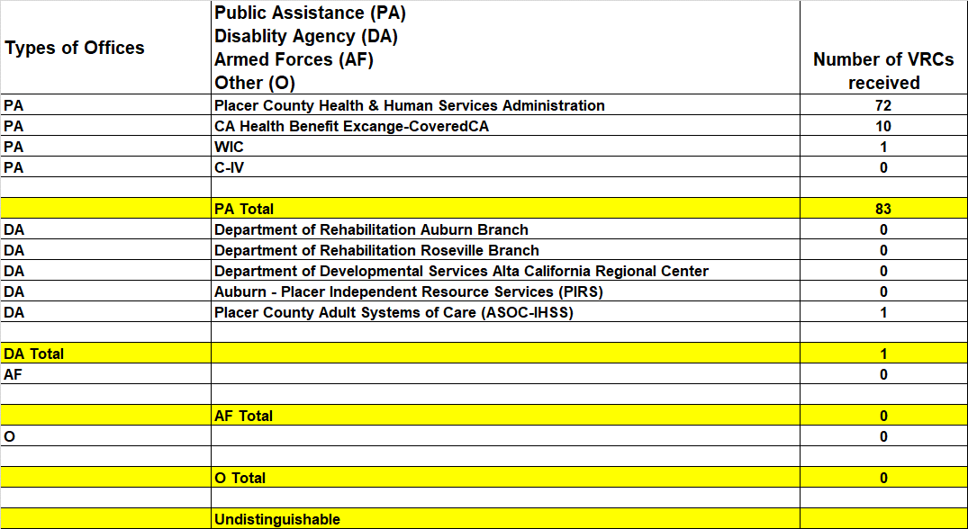
Example Monthly Reporting Spreadsheet
Notes:
This slide shows an example of a completed Monthly Reporting Spreadsheet. Once the spreadsheet is completed, you can transfer the category totals from the spreadsheet to the County Reporting Memo PDF.

Slide 35
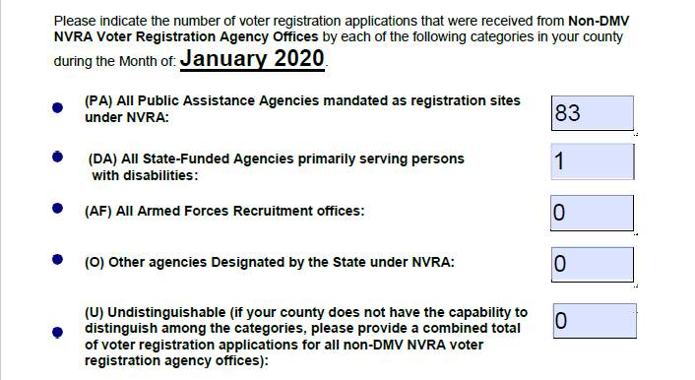
County Reporting Memo (PDF)
Category totals must match the spreadsheet
Fill in all fields
If there is nothing to report enter 0
Notes:
Here is an example of a County Reporting Memo PDF, where the category totals from the Monthy Reporting Spreadsheet have been used to populate the PDF. Category totals listed on the County Reporting Memo (PDF) must be identical to the category totals from the Monthly Reporting Spreadsheet. For example, the PA Total listed on the spreadsheet must equal the PA amount entered into the PDF, the DA Total listed on the spreadsheet must equal the DA amount entered into the PDF, etc. Please fill in all fields on the County Reporting Memo (PDF); if there is nothing to report for a specific category, please report “0”. Please use numeric values only in the voter registration application count fields; do not enter “N/A” or the word “zero”.

Slide 36
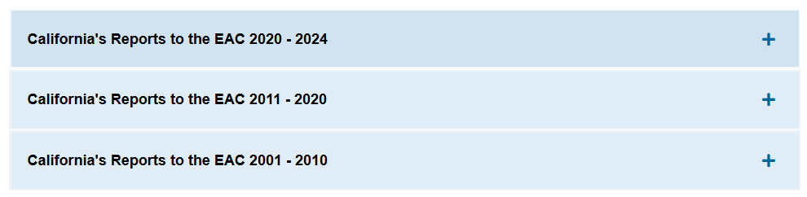
EAC Reports
Report voter registration statistics every two years to the EAC
Link to California's EAC Reports on SOS website
If you need help with tracking or reporting, contact the SOS
Notes:
In addition to the monthly reporting requirement, your offices must report your registration statistics every two years to the U.S. Election Assistance Commission. This biennial report also includes all voter registrations generated online through the unique URLs issued to voter registration agencies and paper registrations from SOS-tracked agencies.
These reports can be found at www.sos.ca.gov/elections/voter-registration/nvra/reports/.

Slide 37
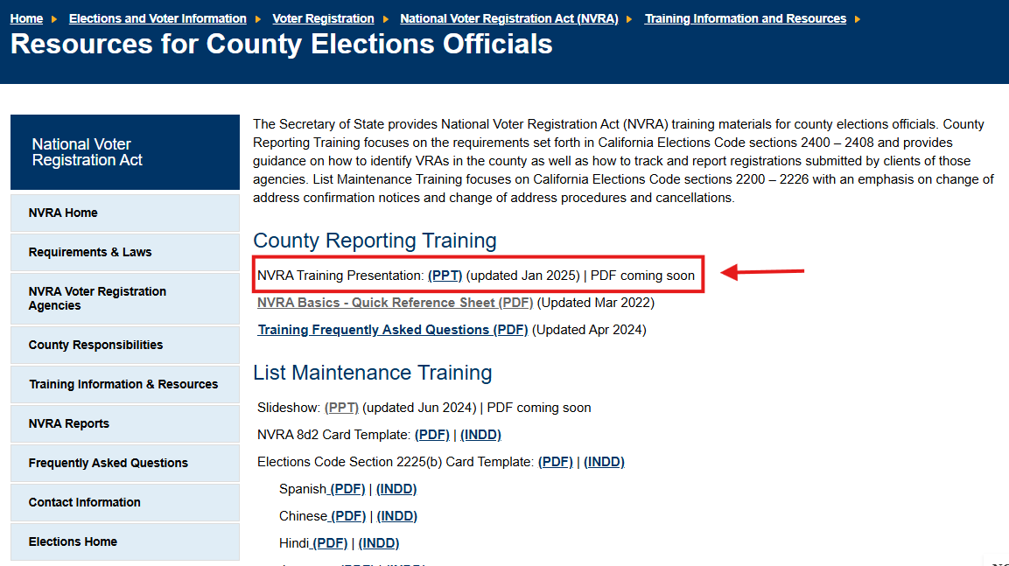
Training for County Elections Officials
Link to County Training Page
Notes:
On our website, we have a number of NVRA training resources for county elections officials. In addition to this slideshow, we also have a slideshow on list maintenance, and a training FAQ.

Slide 38
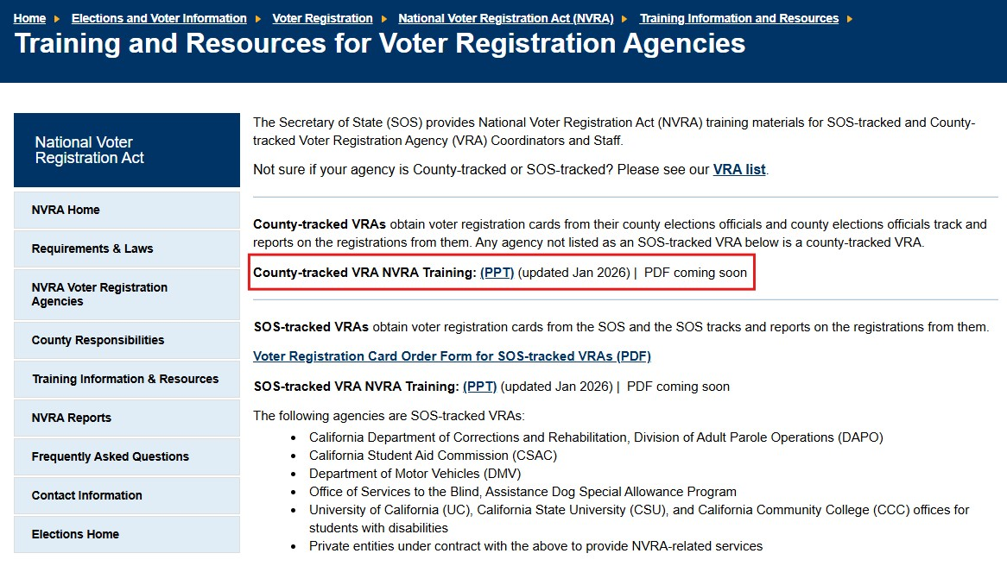
Assisting VRAs with Training
Link to VRA Training Page
Notes:
The final responsibility that county elections offices have is to provide training to Voter Registration Agencies upon request.
On our website, we have training resources that you are welcome to use, including the previously mentioned FAQs, as well as in-depth slideshows that are tailored specifically for County-tracked and SOS-tracked VRAs.
You can find those resources by clicking the appropriate link on our VRA training page.

Slide 39

Voter Registration in Action at VRAs
NVRA Forms
NVRA Transactions
VRA Staff Responsibilities
VRA Staff Guidance
Notes:
Now we are going to talk about what voter registration looks like in action at VRA offices so you will have an idea of the procedures they must follow. We will review the 2 NVRA forms VRAs are required to have available and when they are required to offer those forms. We will let you know what VRA staff are responsible for and how VRA Coordinators can ensure compliance with the NVRA at their agencies. And lastly, we will go over some of the guidance we provide to the VRAs when we train them.

Slide 40
NVRA Forms
Two Forms:
Voter Preference Form (VPF)
Voter Registration Application
Notes:
There are two forms required by the NVRA. The Voter Preference Form (VPF) and the Voter Registration application. VRA staff must provide clients with these two forms when offering voter registration.

Slide 41
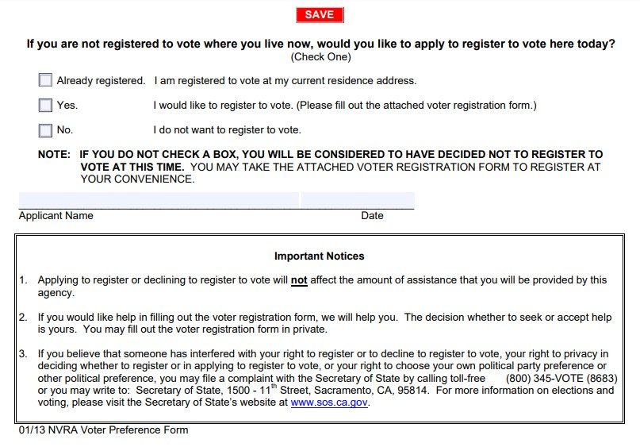
VPF
Available on the SOS website in 10 languages.
VRAs advised to contact their County Elections office or SOS for language information
Link to Voter Preference Forms
Notes:
The VPF is available on the SOS website in the same 10 languages that VRCs come in. This is not a form that your office needs to provide; VRAs will download the form from our website.
This is an example of the English version of the VPF. It simply asks if the person would like to register to vote and allows for a yes or no answer. There is space on the form to list the applicant’s name and the date. It does not require a signature. It lists important notices at the bottom letting the client know their benefits will not be affected by their answer.
We let VRAs know if they are not sure which languages are required in their county to contact your office or the SOS for guidance.

Slide 42
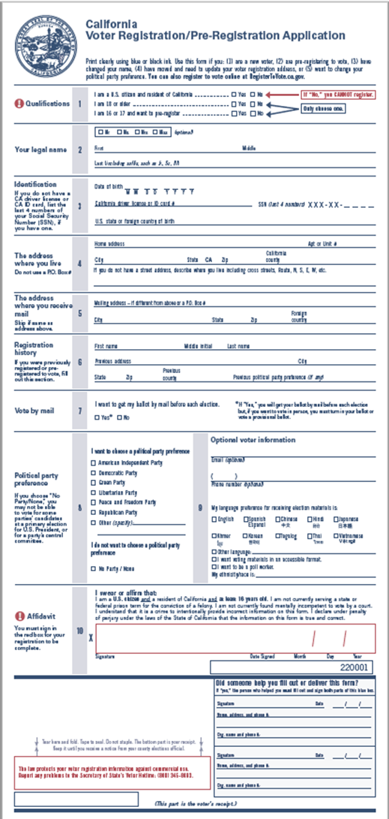
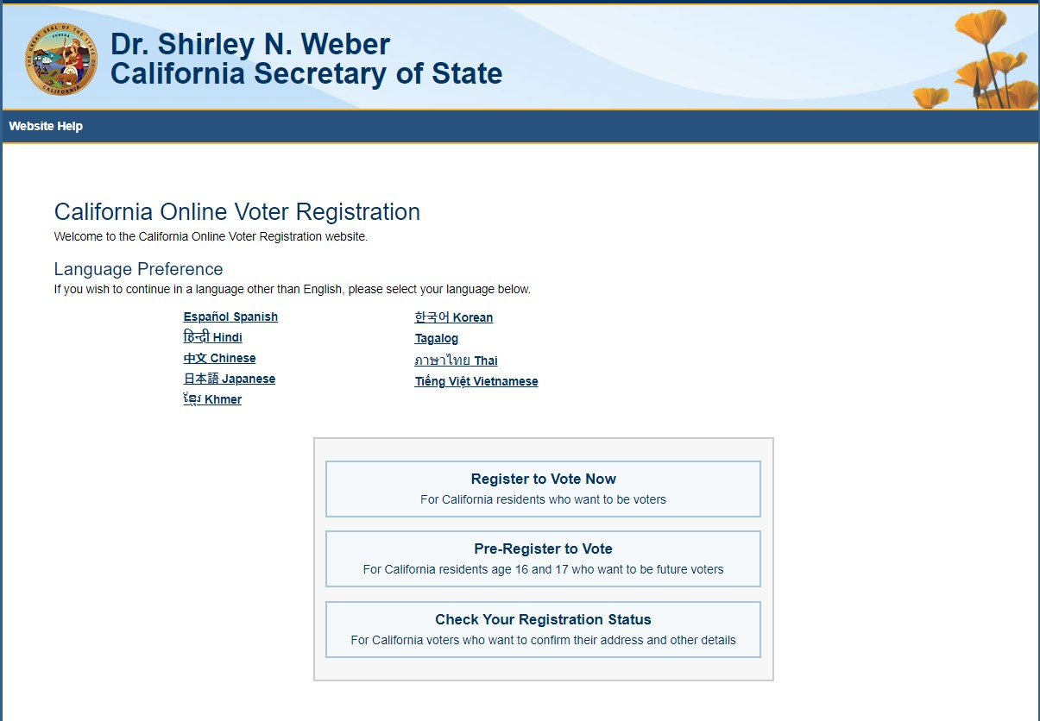
Voter Registration Application
Notes:
VRAs are required to help voters fill out the voter registration application. We go over how to fill out both the paper form and the online form with them during VRA training.

Slide 43

NVRA
Transactions
VRAs must offer voter registration:
At the time of application for new services or benefits
At the time of renewal or recertification
Upon notification of change of address
Notes:
VRAs are required to offer voter registration at three different points:
when a client applies for new services or benefits
when they renew or recertify their benefits
when they change their address

Slide 44

Types of Transactions
Voter registration must be offered on transactions:
In person
By phone or video call
By mail
Online
Offsite
Applicant/client must receive a voter registration application unless they have indicated that they do not want to register.
Notes:
VRAs must offer clients the opportunity to register to vote on all types of transactions including those that take place in person, by phone or video call, by mail, online or offsite.
If a client responds yes to the voter preference form question, indicating they would like to register to vote, the VRA must provide them with a voter registration application. They can provide the application in either paper form or as an online link or QR code. How they provide the VPF and the application depends on how they offer their agencies own application. If their agency has an online application for services, then both the VPF and VRC must be offered online.
The client must receive a voter registration application from the VRA unless they have indicated, in response to the VPF question, that they do not want to register. VRAs are required to document each clients answer to the VPF question and retain it for two years.

Slide 45

VRA Staff Responsibilities
VRA Staff
Offer Voter Registration/Assist Clients
Receive Annual Training
Order VRCs
VRA Coordinators
Inventory VRCs
Review NVRA Reports
Onboarding/Annual Trainings
Notes:
VRA staff that assist clients with their agency’s application, renewal or change of address processes are required to offer voter registration to clients and to help them register to vote, when requested. They need to establish a relationship with their VRA Coordinator and make sure they receive NVRA training each year.
Every Voter Registration Agency must designate a VRA Coordinator at each location. The coordinators are responsible for making sure the VRA complies with NVRA requirements.
When we train the VRAs we always tell them to let your office know they are a voter registration agency when they order VRCs so that you can track those cards and the agency will get credit for any registrations.
If one of the SOS-tracked VRAs contacts you to request VRCs, please do not issue them VRCs, refer them to our office.
We recommend each VRA maintain an inventory sheet to track their supply of VRCs and we suggest they track them by affidavit number and by location. We let them know It is best practice to also track them by language. An accurate inventory listing can be helpful if we need to investigate any possible reporting anomalies.
We also show the VRA Coordinators how to check the monthly reports to make sure their registration numbers are being reported accurately.
VRA Coordinators are responsible for ensuring that employees who assist clients in their agency’s application, renewal, or change of address processes receive NVRA training once per year and that new employees are trained promptly.

Slide 46


VRA Staff Guidance
Voter Registration Eligibility Guidelines
Do’s:
Encourage voter registration
Recite the voter registration eligibility requirements
Don’ts:
Screen for eligibility
Discourage voter registration
Give the impression that voter registration affects benefits
Influence political party preference
Notes:
When training VRAs, we go over the voter eligibility requirements with them. We advise them not to tell clients whether they are eligible to register to vote, but to recite the voter registration requirements and let them know that county elections offices screen out applicants who are not eligible to vote. We also tell them if someone requests a VRC they must give them one, even if they have concerns about that person’s eligibility. VRA staff are encouraged to promote voter registration.
VRAs are not allowed to give the impression that the decision to register to vote will affect the client’s ability to receive services or benefits. They are also informed they may not influence a client’s political party preference or to discourage clients from registering to vote.

Slide 47
Resources
SOS Website Resources:
NVRA Main page
NVRA Training page
NVRA Training Frequently Asked Questions
NVRA Reports
Resources for Voters with Disabilities
Voting Rights Restored - Persons with a Prior Felony Conviction
Promote the Vote California
Notes:
This slide lists the webpage addresses for some of the NVRA related resources available on the Secretary of State’s website.
There is a link to the NVRA landing page, the NVRA training page where you will find this training presentation. NVRA Frequently Asked Questions, which has a lot of very helpful information. The NVRA reports page where you can check the registrations that have been reported for your agency and make sure everything looks correct.
We’ve also listed links to our resources for voters with disabilities page, voting rights restored for people with a prior felony conviction and a link to our Promote the Vote California page for those of you who would like to be more civically involved.

Slide 48

Secretary of State NVRA Information
SOS NVRA Contact Information:
Email: nvra@sos.ca.gov
Phone: (916) 657-2166
Notes:
Just in case you don’t have it, here is our contact information.
The best way to reach us is by email at nvra@sos.ca.gov.

Slide 49

End of Presentation
Thank you for attending NVRA training. If you have any questions, please do not hesitate to contact us.
Notes:
This brings us to the end of the presentation. We’d like to thank you for viewing the presentation. If you have any questions, please do not hesitate to contact us

