Slide 1


Voter Record Cancellation (Disqualification)
and Restoration:
Mental Incompetency
Module #2
Training for Superior Court Executive Officers and County Elections Officials
Revised September 2024

Slide 2

The requirement for this training is found in statutes listed below, and provides that:
in consultation with the Judicial Council, the Secretary of State shall prepare and deliver a training via a remote web-based learning platform that is accessible through the Secretary of State’s internet website
the training shall contain information about the
  legal standards for voting rights cancellation (disqualification),
  responsibilities of superior court executive officers and county elections officials,
  duties of court investigators, and
  the reporting requirements for courts related to voting rights cancellation (disqualification) and restoration
and
at least annually, each superior court executive officer and each county elections official shall complete this training
Elec. Code, § 2214 (added by Assembly Bill 2841, Statutes of 2022, Chapter 807)
Requirements for Annual Training

Slide 3
  Training audience: superior court executive officers and county elections officials
Module #1 objectives:
  General overview of voter registration records cancellations
  Pre-cancellation notification requirements
Module #2 objectives:
  Instructions for cancellation (disqualification) of voter registration records as of result of mental incompetency, and
  Restoration of the right to vote if found mentally competent
Module #3 objectives:
  Instructions for cancellation of voter registration records as of result of death, felony conviction and imprisonment (and restoration), and the NVRA 8d2 card process
THREE TRAINING MODULES
The required training has been broken up into three modules
This training covers Module #2

Slide 4
Please take note of the following acronyms:
    Elections Code = EC
    Penal Code = PC
    Secretary of State = SOS
    Welfare and Institutions Code = WIC
      Court’s standard:
        finding by clear and convincing evidence that “the person cannot communicate, with or without reasonable accommodations, a desire to participate in the voting process” = the person cannot communicate a desire to participate in the voting process
General Statements

Slide 5
Elections Code sections 2208-2211 (slides 8 through 17)
Court Investigator Duties Related to Voting Rights (slides 18 through 24)
  Probate Code sections 1850, 1850.5, and 1851
  Elections Code section 2209
Superior Court Reporting Requirements for Voting Rights (slides 25 through 37)
  Elections Code section 2211.5
  California Rules of Court, rule 10.970
  Notices: Judicial Council forms
    MC-600 and MC-600A
    How to Submit Notices
Following Receipt of Superior Courts’ Notices, Actions Taken by:
  Secretary of State
  County Elections Officials
Cancellation of Voter’s Registration Record and Restoration:
Mental Incompetency
Focus of This Training

Slide 6
Voting Rights:
Cancellation (Disqualification)
and Restoration
MODULE #2

Slide 7
The California Elections Code provides for the cancellation (disqualification)* of voting rights when …
the mental incompetency of a person is legally established:
  Elections Code section 2208,
  Elections Code section 2209,
  Elections Code section 2210, and
  Elections Code section 2211
  *This type of cancellation requires notice prior to cancellation (Elec. Code, § 2201(c); explained in Module #1)
Voting Rights Disqualification:
Mental Incompetency

Slide 8
A person is presumed competent to vote regardless of the person’s conservatorship status.
A person shall be deemed mentally incompetent, and therefore disqualified from voting if the court finds by clear and convincing evidence that the person cannot communicate a desire to participate in the voting process, and any of the following apply:
Elections Code Section 2208
Cancellation (Disqualification) of Voting Rights

Slide 9
A conservator for the person or the person and estate is appointed pursuant to Probate Code section 1400 et seq.
A conservator for the person or the person and estate is appointed pursuant to WIC section 5350 et seq.
A conservator is appointed for the person:
  pursuant to proceedings initiated under WIC section 5352.5
  the person has been found not competent to stand trial, and
  the person’s trial or judgment has been suspended pursuant to PC section 1370
A person:
  has pleaded not guilty by reason of insanity,
  has been found to be not guilty pursuant to PC section 1026, and
  is deemed to be gravely disabled at the time of judgment as defined in WIC section 5008(h)(2)
Elections Code Section 2208 (cont’d)

Slide 10
If the proceeding under the Welfare Institutions Code is heard by a jury (instead of a court):
the jury shall unanimously find by clear and convincing evidence, that the person cannot communicate, with or without reasonable accommodations, a desire to participate in the voting process before the person shall be disqualified from voting.
If an order establishing a conservatorship is made and in connection with the order it is found by clear and convincing evidence that the person cannot communicate, with or without reasonable accommodations, a desire to participate in the voting process, the court shall provide notice to the Secretary of State pursuant to Section 2211.5.
Elections Code Section 2208 - Jury
Cancellation (Disqualification) of Voting Rights (cont’d)

Slide 11
For conservatorships established pursuant to Probate Code section 1400 et seq.:
the court investigator shall:
Review the person’s capability of communicating a desire to participate in the voting process during the yearly or biennial review of the conservatorship as required by Probate Code section 1850 et seq.
Elections Code Section 2209
Probate Code Conservatorship

Slide 12
If the person has been disqualified from voting by reason of being incapable of:
Communicating a desire to participate in the voting process,
OR
Completing an affidavit of voter registration,
…the court investigator shall:
Determine if the person continues to be incapable of communicating a desire to participate in the voting process,
AND
Inform the court
Elections Code Section 2209
Probate Code Conservatorship (cont’d)

Slide 13
Findings of the court investigator:
If a determination is made that the person continues to be incapable of communicating a desire to participate in the voting process,
  a court hearing on the issue is unnecessary
If a determination is made that the person is not incapable of communicating a desire to participate in the voting process,
the court shall hold a hearing to determine if, by clear and convincing evidence, the person cannot communicate a desire to participate in the voting process
unless the person is found incapable of communicating that desire,
  the person’s right to register to vote shall be restored, and
  The court shall provide notice to the SOS pursuant to Elections Code section 2211.5.
Elections Code Section 2209
Probate Code Conservatorship (cont’d)

Slide 14
If the person has not been found incapable of communicating a desire to participate in the voting process,
and
the court investigator determines that the person is no longer capable of communicating that desire, the investigator shall so notify the court.
The court shall hold a hearing to determine if, by clear and convincing evidence, the person cannot communicate a desire to participate in the voting process.
If the court determines that the person cannot communicate that desire, the court shall:
order the person to be disqualified from voting pursuant to Elections Code section 2208, and
provide notice to the SOS pursuant to Elections Code section 2211.5
Elections Code Section 2209
Probate Conservatorship (cont’d)

Slide 15
If the person or the person and estate is under a conservatorship established pursuant to WIC section 5350 et seq.:
The person may contest their disqualification from voting pursuant to the procedure set forth in WIC section 5358.3.
When this conservatorship terminates after one year,
  the person’s right to register to vote shall be automatically restored and
  the court shall provide notice to the SOS pursuant to Elections Code section 2211.5.
  if a petition is filed for the reappointment of the conservator, a new determination shall be made as to whether the person should be disqualified from voting.
The court shall provide notice to the SOS pursuant to Elections Code section 2211.5, if:
  the right to vote is restored pursuant to WIC section 5358.3, or
  the conservatorship is terminated in a proceeding held pursuant to WIC section 5364
Elections Code Section 2210
Welfare and Institutions Code - Conservatorship

Slide 16
A person shall be disqualified from voting or registering to vote during that time that the person is involuntarily confined, pursuant to a court order, in a public or private treatment facility, if the person has:
plead not guilty by reason of insanity and who has been found to be not guilty pursuant to PC section 1026,
been found incompetent to stand trial and whose trial or judgment has been suspended pursuant to PC section 1370,
been convicted of a felony and who was judicially determined to be a mentally disordered sex offender pursuant to former WIC section 6300, or
been convicted of a felony and is being treated at a state hospital pursuant to PC section 2684.
Elections Code Section 2211
Confined to a Treatment Facility

Slide 17
The court shall provide notice to the SOS pursuant to Elections Code section 2211.5 when either of the following occur:
  upon the order of commitment to a treatment facility
  if the person is later released from the public or private treatment facility
Elections Code Section 2211
Confined to a Treatment Facility (cont’d)

Slide 18
Court investigator duties related to the yearly or biennial review of conservatorships, and voting rights disqualification and restoration are found in:
Probate Code sections 1850, 1850.5, and 1851
and
Elections Code section 2209
Court Investigator Duties

Slide 19
Probate Code section 1850(a) provides:
(a) Except as provided in subdivision (e), each conservatorship established pursuant to this part shall be reviewed by the court as follows:
(1) Six months after the initial appointment of the conservator, the court investigator shall visit the conservatee, conduct an investigation as provided in subdivision (a) of Probate Code section 1851, and report to the court regarding the appropriateness of the conservatorship and whether the conservator is acting in the best interests of the conservatee regarding the conservatee’s placement, quality of care, including physical and mental health treatment, and finances. In response to the investigator’s report, the court may take appropriate action including, but not limited to, ordering a hearing or ordering the conservator to submit an accounting pursuant to subdivision (a) of PC section 2620.
(2) One year after the initial appointment of the conservator and annually thereafter, the court investigator shall, as provided in Probate Code section 1851, visit the conservatee, conduct an investigation, including, when possible, discussing with the conservatee less restrictive alternatives to conservatorship as set forth in Probate Code section 1800.3, and report the findings of the investigation to the court, including whether the conservator or conservatee wishes to modify or terminate the conservatorship and whether less restrictive alternatives could be tried. On receipt of the investigator’s report, the court shall, if indicated by the report, consider promptly terminating or modifying the conservatorship at a hearing pursuant to Probate Code section 1860.5 or 1863 and take any other appropriate action.
Court Investigator Duties:
Probate Code Section 1850(a)

Slide 20
Probate Code section 1850.5(a) provides:
(a) Notwithstanding Probate Code section 1850, each limited conservatorship for a developmentally disabled adult, as defined in subdivision (d) of Probate Code section 1801, shall be reviewed by the court one year after the appointment of the conservator and biennially thereafter.
Court Investigator Duties:
Probate Code Section 1850.5

Slide 21
Probate Code section 1851(a)(1)(E) provides:
(a) (1) If court review is required pursuant to Probate Code section 1850 or 1850.5, the court investigator shall, without prior notice to the conservator except as ordered by the court for necessity or to prevent harm to the conservatee, visit the conservatee. The court investigator shall inform the conservatee personally that the conservatee is under a conservatorship and shall give the name of the conservator to the conservatee. The court investigator shall determine all of the following: ….
(E) (i) If the conservatee is incapable of communicating, with or without reasonable accommodations, a desire to participate in the voting process and may be disqualified from voting pursuant to Elections Code section 2208 or 2209.
(ii) The conservatee shall not be disqualified from voting on the basis that the conservatee does, or would need to do, any of the following to complete an affidavit of voter registration:
  (I) Signs the affidavit of voter registration with a mark or a cross pursuant to subdivision (b) of Section 2150 of the Elections Code.
  (II) Signs the affidavit of voter registration by means of a signature stamp pursuant to Section 354.5 of the Elections Code.
  (III) Completes the affidavit of voter registration with the assistance of another person pursuant to subdivision (d) of Section 2150 of the Elections Code.
  (IV) Completes the affidavit of voter registration with reasonable accommodations.
Court Investigator Duties:
Probate Code Section 1851(a)(1)(E)

Slide 22
Elections Code section 2209 provides:
For conservatorships established pursuant to Division 4 (commencing with Section 1400) of the Probate Code, the court investigator shall:
during the yearly or biennial review of the conservatorship as required by Chapter 2 (commencing with Section 1850) of Part 3 of Division 4 of the Probate Code, review the person’s capability of communicating, with or without reasonable accommodations, a desire to participate in the voting process.
Court Investigator Duties:
Elections Code Section 2209

Slide 23
If the person has been disqualified from voting
by reason of being incapable of communicating, with or without reasonable accommodations, a desire to participate in the voting process, or
by reason of being incapable of completing an affidavit of voter registration,
The court investigator shall determine if the person continues to be incapable of communicating, with or without reasonable accommodations, a desire to participate in the voting process, and the investigator shall so inform the court.
If the investigator determines that the person continues to be incapable of communicating, with or without reasonable accommodations, a desire to participate in the voting process, a court hearing on the issue is unnecessary.
If the investigator finds that the person is not incapable of communicating, with or without reasonable accommodations, a desire to participate in the voting process, the court shall hold a hearing to determine if, by clear and convincing evidence, the person cannot communicate, with or without reasonable accommodations, a desire to participate in the voting process.
  unless the person is found incapable of communicating that desire, the person’s right to register to vote shall be restored, and
  the court shall provide notice to the Secretary of State pursuant to Elections Code section 2211.5.
Court Investigator Duties:
Elections Code Section 2209 (cont’d)

Slide 24
If the person has not been found incapable of communicating, with or without reasonable accommodations, a desire to participate in the voting process, and
the court investigator determines that the person is no longer capable of communicating that desire,
  the investigator shall so notify the court.
  the court shall hold a hearing to determine if, by clear and convincing evidence, the person cannot communicate, with or without reasonable accommodations, a desire to participate in the voting process.
    if the court determines that the person cannot communicate that desire, the court shall order the person to be disqualified from voting pursuant to Elections Code section 2208, and
    the court shall provide notice to the Secretary of State pursuant to Elections Code section 2211.5.
Court Investigator Duties:
Elections Code Section 2209 (cont’d)

Slide 25
Under circumstances set forth in both the Elections Code and the Welfare and Institutions Code, superior courts must provide notice to the SOS
Elections Code section 2211.5 provides the language of the notice
California Rules of Court, rule 10.970 specifies the process for the superior courts to use to submit the notice provided by Elections Code section 2211.5
Judicial Council forms:
  Confidential Report of Findings and Orders Affecting Voting Rights (form MC-600)
    meets with the notice requirements of Elections Code section 2211.5
    mandatory form
  Attachment to Confidential Report of Findings and Orders Affecting Voting Rights (form MC-600A)
    optional form to submit information required by Elections Code section 2211.5(a)(1), (b)
    or
  A computer-generated document that present the required information for the period covered by the report using the same clearly identified spaces as form MC-600A.
Court Reporting Requirements

Slide 26
The Elections Code requires notice to the SOS under these sections:
Elections Code section 2208
    if an order establishing a conservatorship is made and it is found by clear and convincing evidence that the person cannot communicate a desire to participate in the voting process
      notice to the SOS is required
Court Reporting Requirements:
When Notice is Required – Elections Code

Slide 27
    Elections Code section 2209 –
    If a person had previously been disqualified from voting by reason of being incapable of communicating a desire to participate in the voting process, or by reason of being incapable of completing an affidavit of voter registration, …
      …but a court investigator finds that the person is not incapable of communicating that desire, the court shall hold a hearing.
      Unless the person is found incapable of communicating that desire,
          the person’s right to register to vote shall be restored, and
          notice to the SOS is required
        If a person had NOT previously been found incapable of communicating a desire to participate in the voting process, …
          …but a court investigator determines the person is incapable of communicating that desire, the court shall hold a hearing.
          If the person is found incapable of communicating that desire,
          The court shall order the person to be disqualified from voting pursuant to Elections Code section 2208, and
          notice to the SOS is required
Court Reporting Requirements:
When Notice is Required – Elections Code (cont’d)

Slide 28
Elections Code section 2210 – if a person or person and estate is under a conservatorship established pursuant to WIC section 5350 et seq.
the person may contest their disqualification from voting pursuant to the procedure set forth in WIC section 5358.3
      if person’s right to register to vote is restored
          notice to the SOS is required
when the conservatorship terminates after one year,
  the person’s right to register to vote shall be automatically restored
  notice to the SOS is required
if the conservatorship is terminated in a proceeding held pursuant to WIC section 5364,
  notice to the SOS is required
Court Reporting Requirements:
When Notice is Required – Elections Code (cont’d)

Slide 29
Elections Code section 2211 –
If a person has
  plead not guilty by reason of insanity and has been found to be not guilty pursuant to PC section 1026
  been found incompetent to stand trial and their trial or judgment has been suspended pursuant to PC section 1370
  been convicted of a felony and was judicially determined to be a mentally disordered sex offender pursuant to former WIC section 6300, or
  been convicted of a felony and is being treated at a state hospital pursuant to PC section 2684
  that person shall be disqualified from voting or registering to vote during that time that the person is involuntarily confined, pursuant to a court order, in a public or private facility
upon the order of commitment to one of the above-listed treatment facilities
  notice to the SOS is required
if the person is later released from the treatment facility
  notice to the SOS is required
Court Reporting Requirements:
When Notice is Required – Elections Code (cont’d)

Slide 30
As already indicated in slide number 15
The Welfare and Institutions Code requires notice to the SOS under these sections:
WIC section 5358.3 – At any time, a conservatee or any person on the conservatee’s behalf with the consent of the conservatee or the conservatee’s counsel,
  may petition the court for a hearing to contest the rights denied under WIC section 5357 or the powers granted to the conservator under WIC section 5358.
    if a person’s right to vote is restored
    notice to the SOS is required
WIC section 5364 – At any time, the conservatee
  may petition the superior court for a rehearing as to their status as a conservatee
    if the conservatorship is terminated pursuant to this section
    notice to the SOS is required
Court Reporting Requirements:
When Notice is Required – Welfare and Institutions Code

Slide 31
By the first day of each month, and more frequently if the clerk so chooses, the clerk of the superior court of each county shall notify the SOS of each of the following:
  all findings made by the court regarding any person’s competency to vote, as specified in each of Elections Code sections 2208 - 2211, inclusive, since the clerk’s last report, and
  the total number of proceedings, as specified in Elections Code section 2208(a)(1)-(4), that occurred in that court since the clerk’s last report.
Court Reporting Requirements:
Notice Prescribed by Elections Code Section 2211.5

Slide 32
The courts shall use the Judicial Council forms with spaces for:
personal identification information for the affected person, including all of the following:
  all known first names, last names and middle names,
    all known name suffixes,
    last known address,
    date of birth,
    last four digits of the person’s social security number, if available,
    driver’s license or state-issued identification number, if available,
  the court case number,
  the date of the order affecting the individual’s voting rights,
  whether the court’s order is made pursuant to Elections Code section 2208, 2209, 2210, or 2211,
  whether the legal effect of the order is a disqualification or a restoration of the right to vote, and
  a certification, if applicable, that the individual has been disqualified from voting due to the court’s finding by clear and convincing evidence that the individual is incapable to communicate a desire to participate in the voting process
Court Reporting Requirements:
Notice Prescribed by Elections Code Section 2211.5 (cont’d)

Slide 33
California Rules of Court, rule 10.970 specifies the process for the superior courts to use to submit the notice provided by Elections Code section 2211.5.
Rule 10.970 Reports of findings and orders affecting voting rights (Elections Code section 2211.5)
    Application
    This rule applies to the reports required by Elections Code section 2211.5 regarding findings and orders disqualifying a person from voting or restoring a person’s right to register to vote under Elections Code sections 2208–2211.
    (b) Forms
    The clerk must use Confidential Report of Findings and Orders Affecting Voting Rights (form MC-600) to submit each report under this rule.
      A completed Attachment to Confidential Report of Findings and Orders Affecting Voting Rights (form MC-600A) that includes the required information about each applicable determination made by the court in the period covered by the report; or
    (B) A computer-generated document that presents the required information for the period covered by the report using the same clearly identified spaces as form MC-600A.
Court Reporting Requirements:
Process to Use When Notice is Required

Slide 34
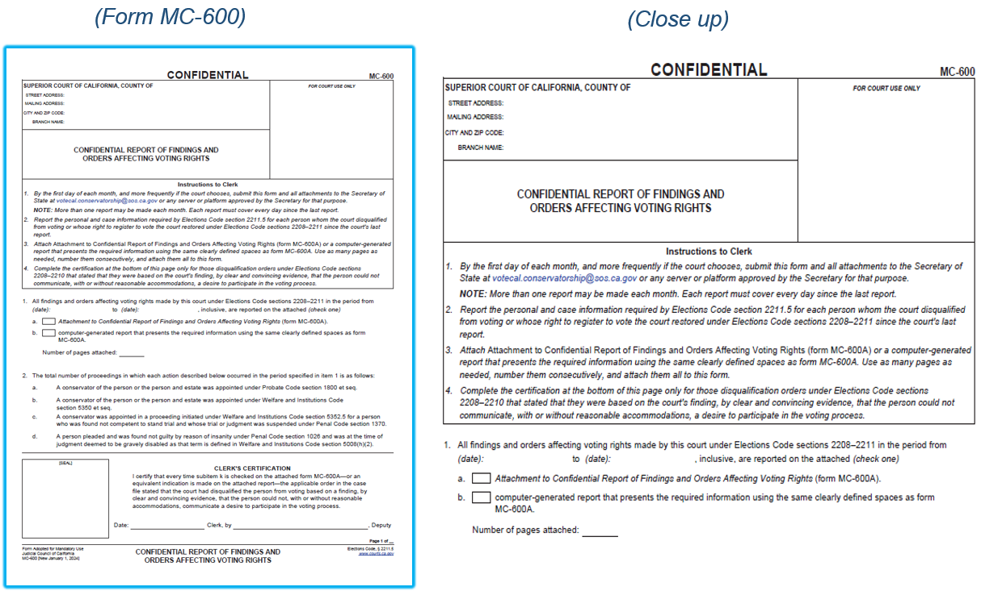
  Confidential Report of Findings and Orders Affecting Voting Rights (form MC-600)
    meets with the requirements of Elections Code section 2211.5
    is a mandatory form
Court Reporting Requirements:
Judicial Council Forms: Form MC-600

Slide 35
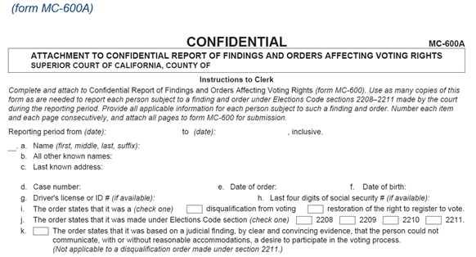
Court Reporting Requirements:
Attachment to Confidential Report of Findings and Orders Affecting Voting Rights (form MC-600A)
    is an optional form to submit information required by Election Code section 2211.5(a)(1) and (b)
Judicial Council Forms: Form MC-600A

Slide 36

Fields for:
County Name
Conservatee’s first, middle and last name
Alias
Date of Birth
Last four of SSN
Driver’s License if available
Court Reporting Requirements:
Judicial Council Forms: Computer-Generated Document Template
Computer-generated reporting optional template
X for Restoration or Disqualification
Court Case Number
Court Order Date
Legal Basis
Last Known Street Address
Unit or Apartment, City, State and Zip Code

Slide 37
Court Reporting Requirements:
The process for submitting notices to the SOS office is via email to:
VoteCal.Conservatorship@sos.ca.gov
Submitting Notices to Secretary of State

Slide 38
Elections Code sections
  2201
  2208
  2209
  2210
  2211
SOS Website
  Voting Rights: Persons Subject to Conservatorship :: California Secretary of State
  Voter Registration Cancellation, Revocation, and Restoration (January 19, 2024)
  CCROV #24039
  Voter Registration Cancellation, Revocation, and Restoration Translated Notices (February 20, 2024)
  CCROV #24053
Information and Resources:

Slide 39
SOS VoteCal Help Desk Contacts
  Phone: (888) 868-3225
  Email: VoteCalHelp@sos.ca.gov
SOS VoteCal Conservatorship Contacts
  Email: VoteCal.Conservatorship@sos.ca.gov
Contact Information

Slide 40
In accordance with Elections Code section 2214(c), specified court executive officers and county elections officials for each county, are required to annually complete the Voting Rights Cancellation (Disqualification) and Restoration (VRCDR) training.
Your attendance and training feedback will be tracked by completing the “VRCDR Training Assessment”, found on the Secretary of State website under County Compliance Training.
Please send your completed assessment to the following Secretary of State mailbox: votecal.conservatorship@sos.ca.gov.
The Secretary of State will monitor attendance in accordance with Elections Code section 2214(c).
Training Assessment

